Slide 1

Product Teardown s
Feature Proposal: Tinder
Enhancing User Discovery Through Proximity-Based Grid View
A Product teardown C Feature Proposal By Prakhar
Email: bprakhar01@gmail.com

Slide 2



About
Tinder is one of the world’s largest dating apps, known for swipe-based matching and casual discovery.
Problem Statement
Users often feel limited by the swipe-only experience.
There’s no quick way to browse multiple nearby profiles or prioritize by proximity — leading to fatigue and inefficient discovery.
Proposed Solution
Introduce a “Grid View by Distance” tab
Unlockable via subscription with 3 free trial uses
Enables visual browsing of nearby and online profiles ranked by proximity
Key Stats
75M+ monthly active users
Available in 190+ countries and 40+ languages
Owned by Match Group (which also owns Hinge, OKCupid
Highest-grossing non-gaming app globally (over
$1.5 billion annual revenue)
Competitors

Slide 3


USER PERSONAS
Varun Khatri , 38
Location: Mumbai (Metro City) Job: Senior Sales Manager, MNC Tinder Usage: Gold Subscriber
Behaviour:
Travels frequently for work
Uses Tinder for casual dates and to meet people in new cities
Wants a fast, efficient way to find nearby matches
Prefers minimal effort with high match efficiency
Pain Points:
Can’t filter by exact distance — leads to wasted swipes
Gets low-quality or faraway matches
Doesn’t get fast replies due to people being offline
Feels the app is not optimized for frequent travellers.
Manya Singh, 26
Location: Bengaluru
Job: IT Analyst C Developer Tinder Usage: Free User
Behaviour:
Wants a serious relationship
Uses the app in evenings/weekends due to long
work hours
Prefers matches nearby — doesn’t want to
travel across the city
Values depth and intent in matches
Pain Points:
Gets matched with people far away
Limited time makes traveling for meetups difficult
Encounters ghosting and inactive users
Feels the current swipe deck is too casual and inefficient.

Slide 4
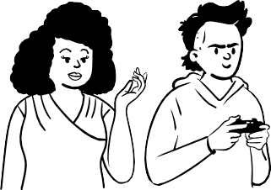

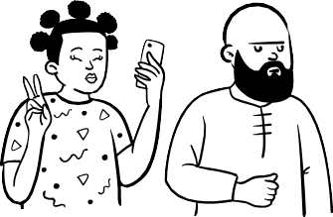
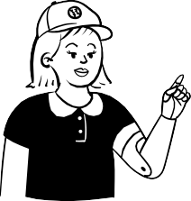
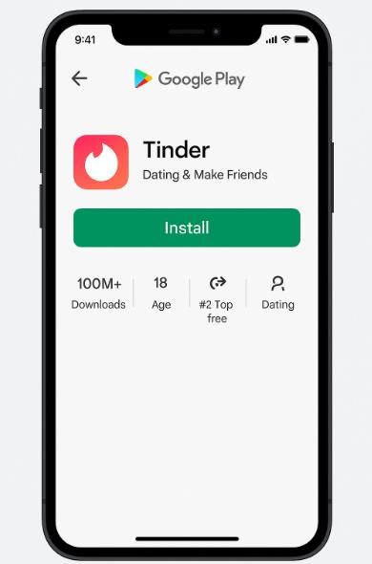
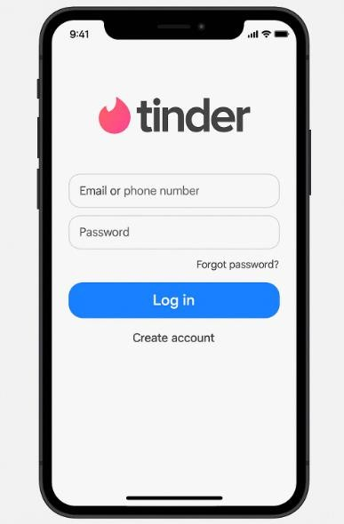
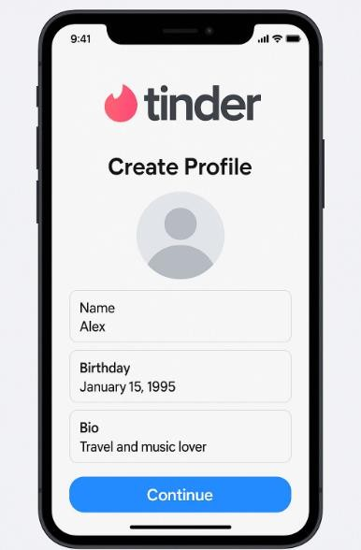
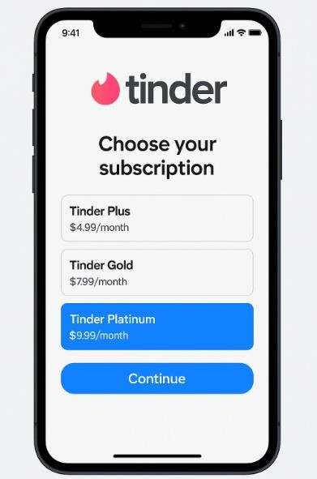
USER JOURNEY
Install Tinder App Download from Play Store / App Store
Sign Up / Log In
Create account via phone number, Google, Apple
Create profile
Basic details, Allow location, set preferences
Subscription:
Plus/Gold/Platinum

Slide 5
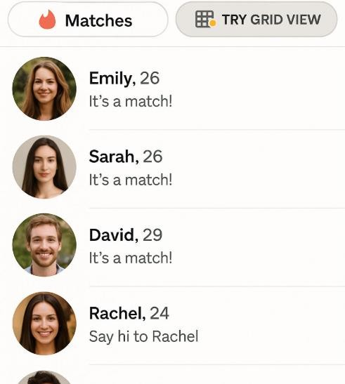
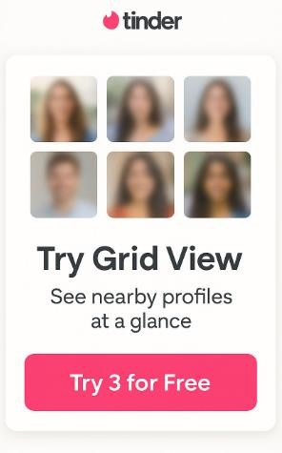
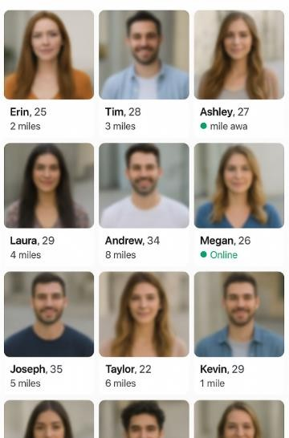
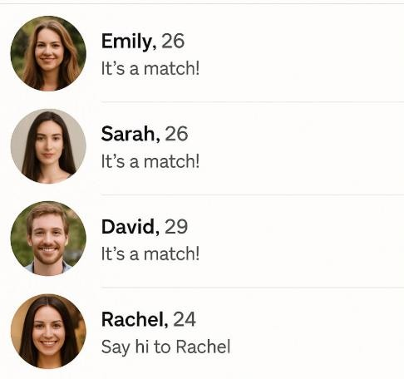
USER JOURNEY
Try Grid View: Opens the Grid Tab (nearby profiles visible)User uses (limited) 3 free sessions
Upgrade to Tinger Gold/Platinum after 3 trials and see grid of nearby profiles with distance tag and online status.
Membership is confirmed and matches are seen after swiping.
Tap Profile → message

Slide 6

Business Benefits
Tie it back to Tinder’s goals: monetization,
engagement, retention.
Drives subscriptions: Teaser → trial → conversion path increases Gold/Platinum upgrades.
perceived value: Adds a premium layer of user control and intent.
Boosts retention: Users come back for more efficient discovery.

Slide 7
Success Metrics
Engagement Metrics
Track whether users are using the Grid View and how often. Time Spent in Grid View
→ Avg. session time in Grid vs.
swipe deck
Grid View Opens per Day
→ How often users come back
to use it
Conversion Metrics Measure the impact on Tinder's revenue stream. Free-to-Paid Conversion Rate
→ % of users upgrading after
trying 3 free Grid sessions
Retention Metrics Check if the feature brings users back.
Return Visits to Grid View
→ Do they try it once and bounce, or become repeat users?

Slide 8
THANKYOU

